Slide 1
The Convergence of the Twain
By Thomas Harding
Danielle Neufville

Slide 2
Thomas Hardy was born in 1840 in Dorchester, where he lived for the majority of his life. He was a novelist as well as a poet, who succeeded and practiced most in the later. His works reflected his educated beginnings. In his twenties he moved to London, working as a mechanic. His therefore intimate knowledge of mechanics is reflected in how he describes the sunken ship in this poem. His works also reflect his declined of religious faith, from when he was a young man. One of his major influences is his sister.His focus for novels changed from opinionated politics and social criticism to romantic novels in order to bring in the largest crowd. Thomas Hardy died in 1928.

Slide 3
The Convergence of the Twain
In the Solitude of the sea
Deep from human vanity,
And the Pride of Life that planned her, stilly couches she
Steel chambers, late the pyres
Of her salamandrine fires
Cold currents thrid, and turn to rhythmic tidal lyres
Over the mirrors meant
To glass the opulent
The sea-worm crawls -- grotesque, slimed, dumb, indifferent
Jewels in joy designed
To ravish the sensuous mind
Lie lightless, all their sparkles bleared and black and blind.
Dim moon-eyed fishes near
Gaze at the gilded gear
And query: "What does this vaingloriousness down here?

Slide 4
Convergence of the Twain
Well:while was fashioning
This creature of cleaving wing,
The immanent Will that stirs and urges everything
Prepared a sinister mate
For her -- so gaily great--
A Shape of Ice, for the time far and dissociate.
And as the smart ship grew
In stature, grace, and hue,
In shadowy silent distance grew the Iceburg too
And as the smart ship grew
In stature, grce and hue,
In shadowy silent distance grew the Iceberg too.
Alien they seemed to be;
No mortal eye could see
The intimte welding of their later history,
Or sign that they were bent
By paths coincident
On being anon twin halves of one august event,

Slide 5
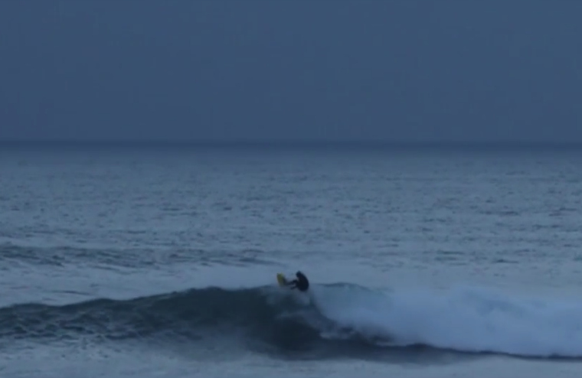
The Titaic lays at the bottom of the ocean, far from the frill and vanity of the people who created her. Those who one enjoyed her now lay forever silent. The fire it once had is lost.
In the Solitude of the sea
Deep from human vanity,
And the Pride of Life that planned her, stilly couches she
Steel chambers, late the pyres
Of her salamandrine fires
Cold currents thrid, and turn to rhythmic tidal lyres

Slide 6
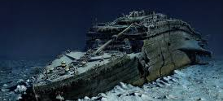
The expensive decor, and jewels are now tarnished and dark. The glory that the Titanic once held now has been rotted into the tragedy it now is. The Titanic, though originally meant to be remembered with pride as the fastest cruise ship in the world and the standard in luxury, it is now remembered as the causer of death for over 1500 people. the ship and its passengers are the same same state as the sea-worm
Over the mirrors meant
To glass the opulent
The sea-worm crawls --grotesque, slimed, dumb, indifferent
Jewels in joy designed
To ravish the sensuous mind
Lie lightless, all their sparkles bearded and black and blind
Dim moon-eyed fishes near
Gaze at the gilded gear
And query: "What does this vingloriousness down here?"
Click to add tex

Slide 7
Well:while was fashioning This creature of cleaving wing, The immanent Will that stirs and urges everything Prepared a sinister mate For her -- so gaily great-- A Shape of Ice, for the time far and dissociate. And as the smart ship grew In stature, grace, and hue, In shadowy silent distance grew the iceburg too This section of the poem, in response the question imposed by the fishes who passed by the old ship's ruins. Here the author indicates that God or fate had fashioned the ice and the ship for each other. They were both formed simultaneously for their destructive meeting

Slide 8
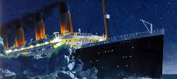
Till the Spinner of the Years Said "Now!" And each one hears, And consummation comes, and jars two hemispheres

