Slide 1
Analysis of Recessional
Poem by Rudyard Kipling

Slide 2
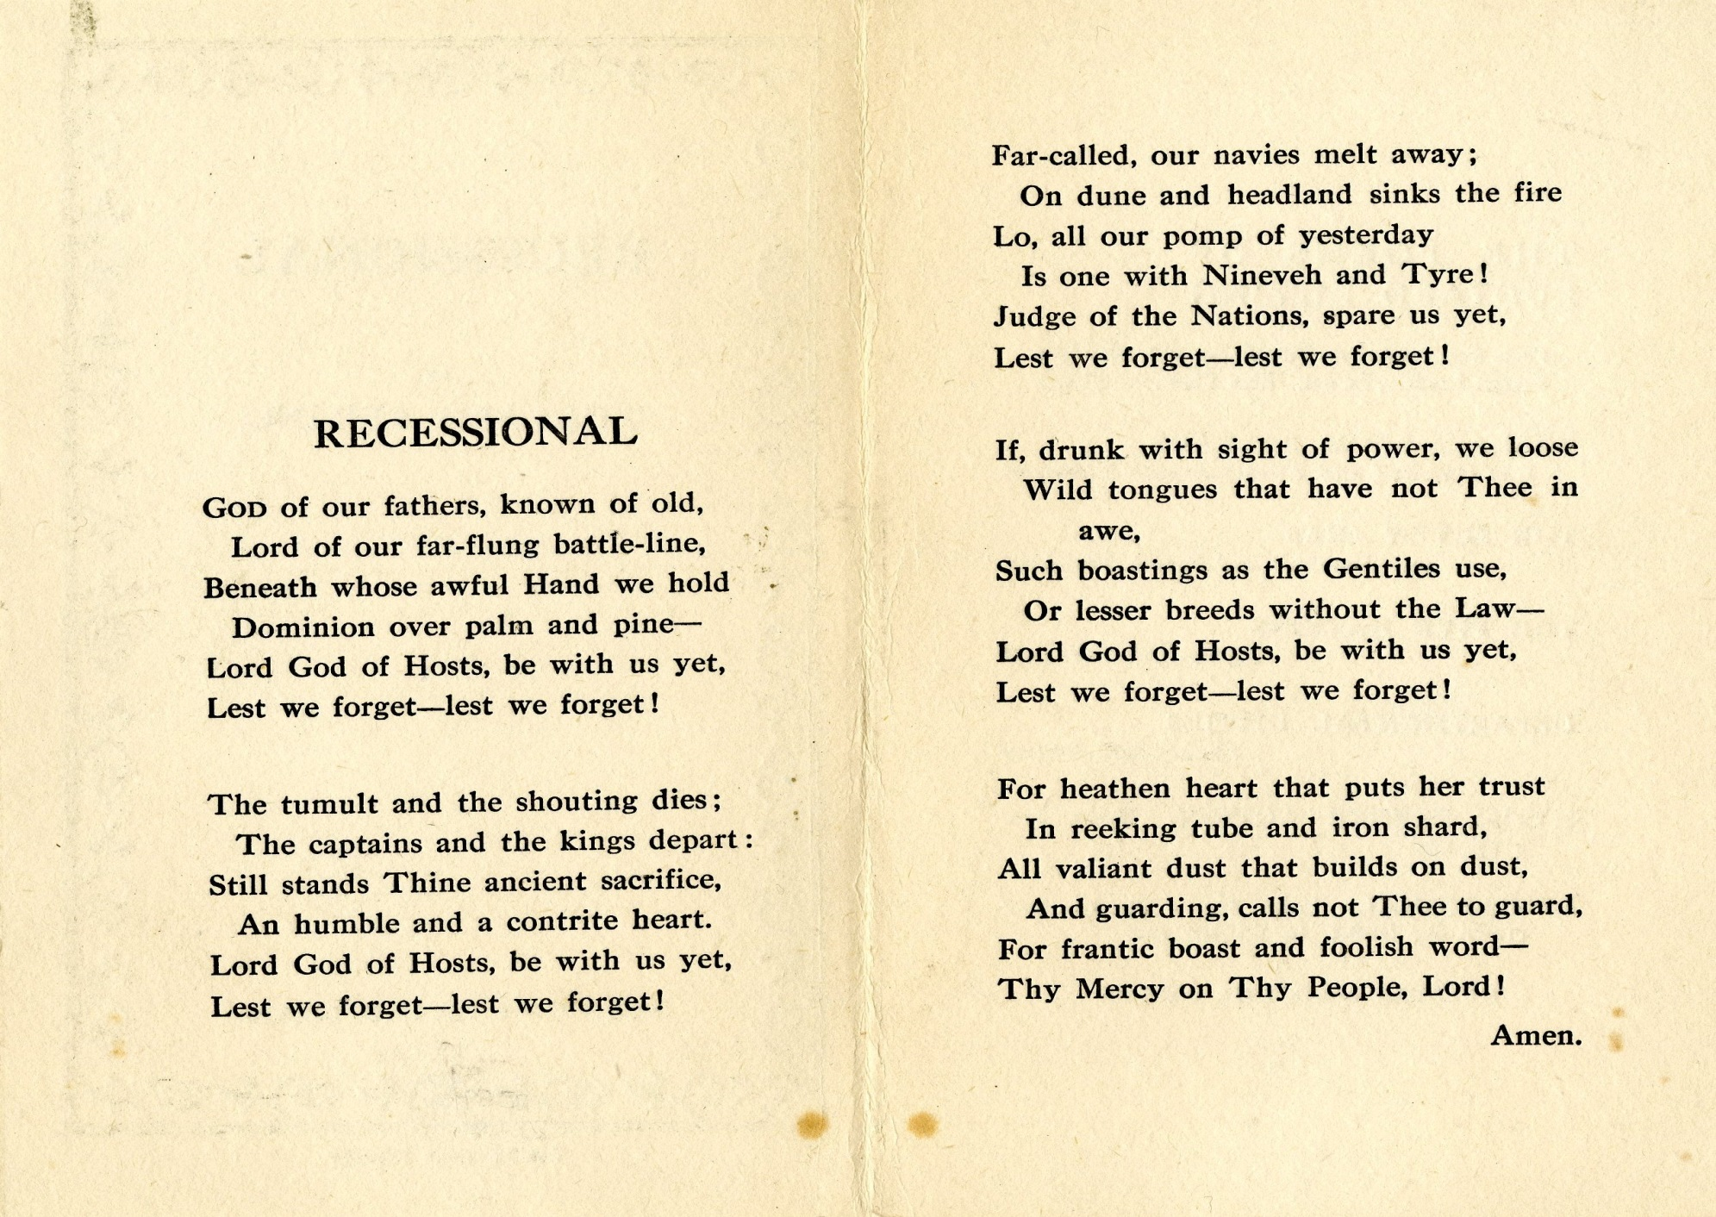

Slide 3
Analysis: History
"Recessional" was written for Queen Victoria's Diamond Jubilee in 1897, which celebrated the 60th anniversary of her reign. The poem is well-known for the biblical phrase "Lest we forget" (see Deuteronomy 6:12) repeated throughout the poem which quickly became a mainstay of memorials and headstones.
It is one of Kipling's more enigmatic and cerebral poems; written during a time when Kipling was frightened by the prospects of England's future.

Slide 4
“For heathen heart that puts her trust
In reeking tube and iron shard,”
Emphasis on not trusting the things of this world.
“Lest we forget—lest we forget!
Emphasis put on the end of every stanza.

Slide 5
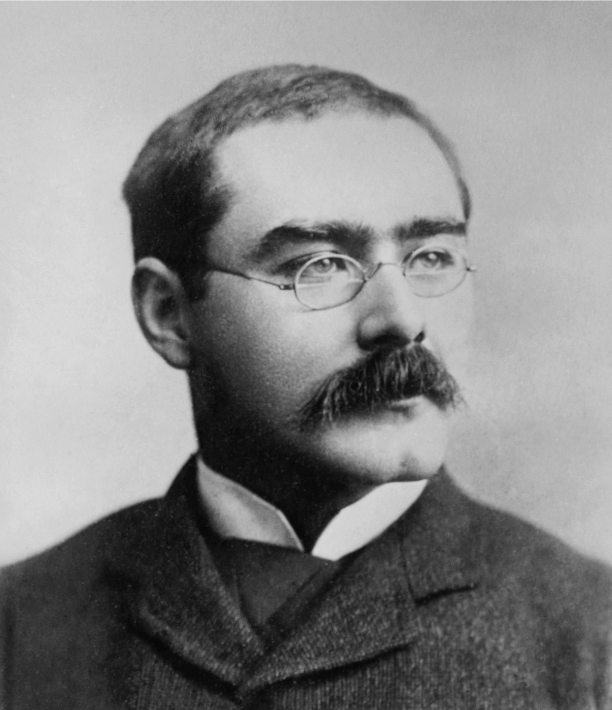
Rudyard Kipling
Born: 30 December 1865, Bombay, British India (now India)
Died: 18 January 1936, London, United Kingdom
Won the Nobel Literature prize in 1907.
One of the first English masters of the short story.
First to use Cockney dialect in poems.

